Slide 1
Dima Hasao District as the significant center of Archaeology in Assam in the Pre-historic period (TDC 1st SEM)
Dr. Golap Saikia
Associate Prof.
Department of History, Haflong Govt. College

Slide 2
Pre-history is the story of human evolution – both physical and cultural of the early people. The story of the human being started with converting the naturally fragmented stones or pebbles into artefacts. The archaeology study about the artifacts. For nearly two million years the early men used stone preparing tools and weapons. Observing the using of the stone for different purposes the pre-history period can be divided into two broad period - the Old Stone Age (Palaeolithic period) and New Stone Age (Neolithic period). Between the two period there is another period that is the Mesolithic period.

Slide 3
Archaeology of Dima Hasao:
Dima Hasao (earlier North Cachar Hills), one of the beautiful hill district on Assam, is located in the natural gap between the towering Barail Ranges of the district in the south-east and the Khasi Jayantia hills of Meghalaya in the north-west. The district maintains the link between the two valleys (i.e. the Brahmaputra and the Barak valley) of Assam and in the pre-historic period due locating the territory in a strategic position the territory had formed the cultural bridge between the East (comprising Kumming, Bhamo, Imphal etc ) and the West through Kapili Valley of ancient Pragjyotisa, Magadh as far as Persia, Greece and Rome.

Slide 4
Like Daojali Hading in some other places of the district archaeological remains discovered by different archaeologists. Some of the important places where large numbers megaliths found in the district are Derabra, Tuivamittlang, Khobak, Bolasan, Khartong and Harangajao. The megalith remains found in N.C.Hills can be categorised as male and female types. The male types are larger whereas the female are smaller. The male ones are generally found in Khartang and Khobak. The specimens of Khobak megaliths are conical in shape rather than bulbous. The stone found in Bolasan have certain similarity with those of Khobak. The stone found at Derebra are most ancient of the male type. At Malanga, also certain specimen of megaliths found namely the menhir – flat on the side and round on the other. Menhirs also found in the area between Kharthong and Wachang. At Tuivamittlang there found three hallowed megaliths measuring the diameter of 96 cm, 59 cm, and 61 cm. One menhir also found in khaluktalang whereon some engraving figures are noticed. A figure of a human being is also found who is standing holding a bow and arrow on the left side and near his feet an elephant is engraved within a circle. Bellow the figure a tiger and bull figure also seen.

Slide 5
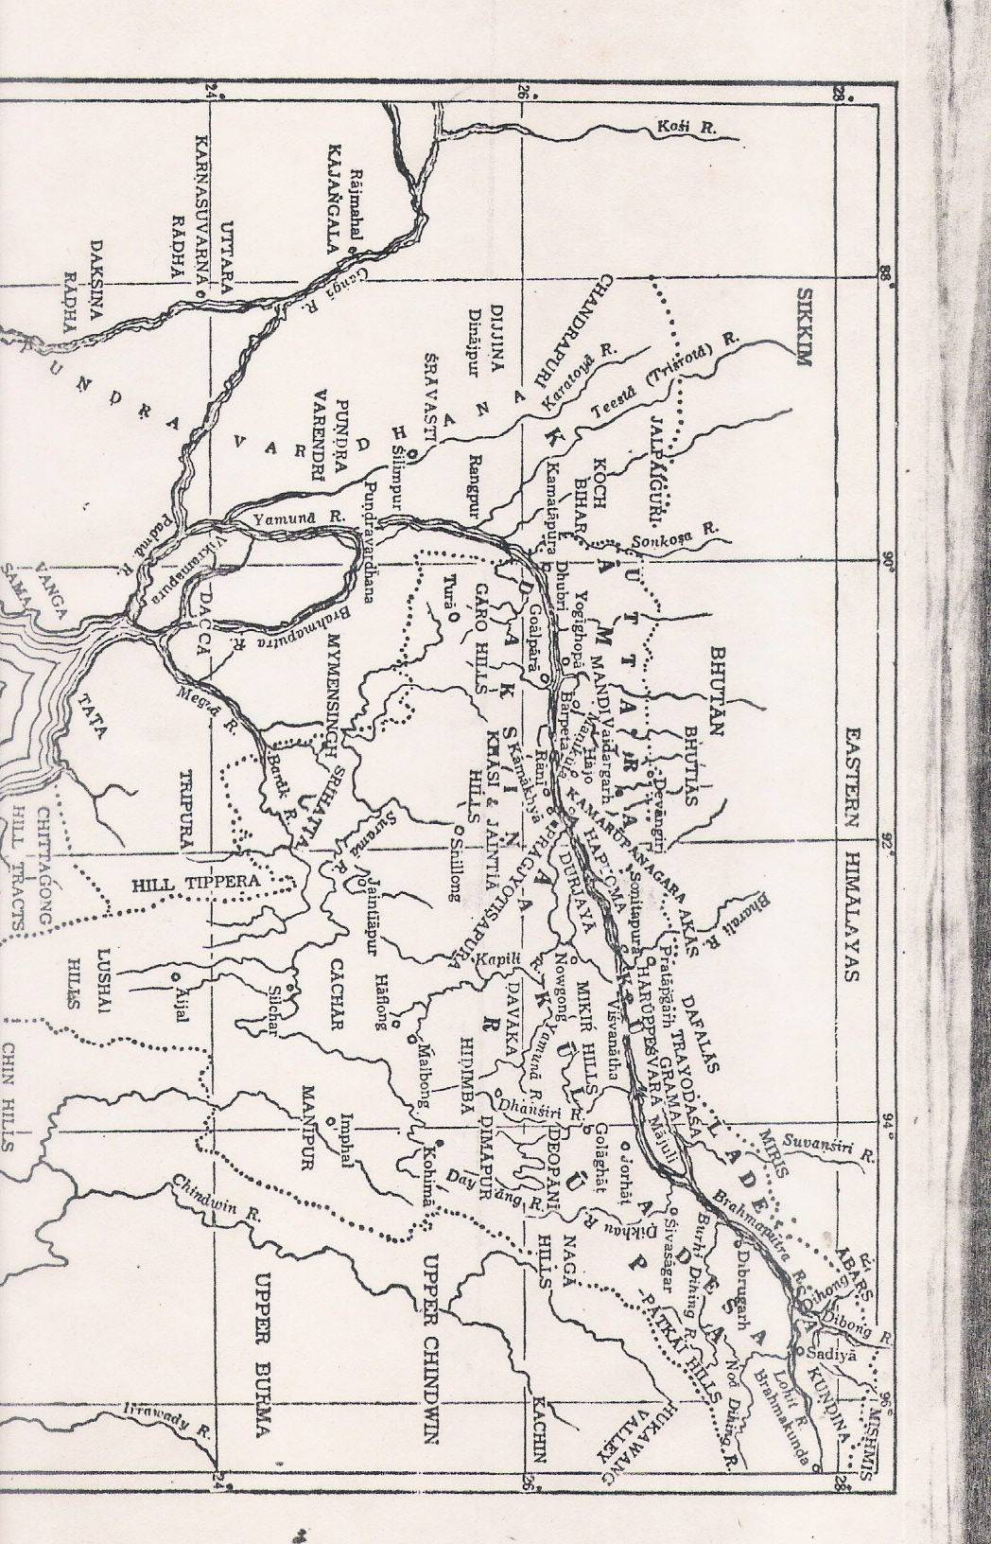
Map of early Assam

Slide 6
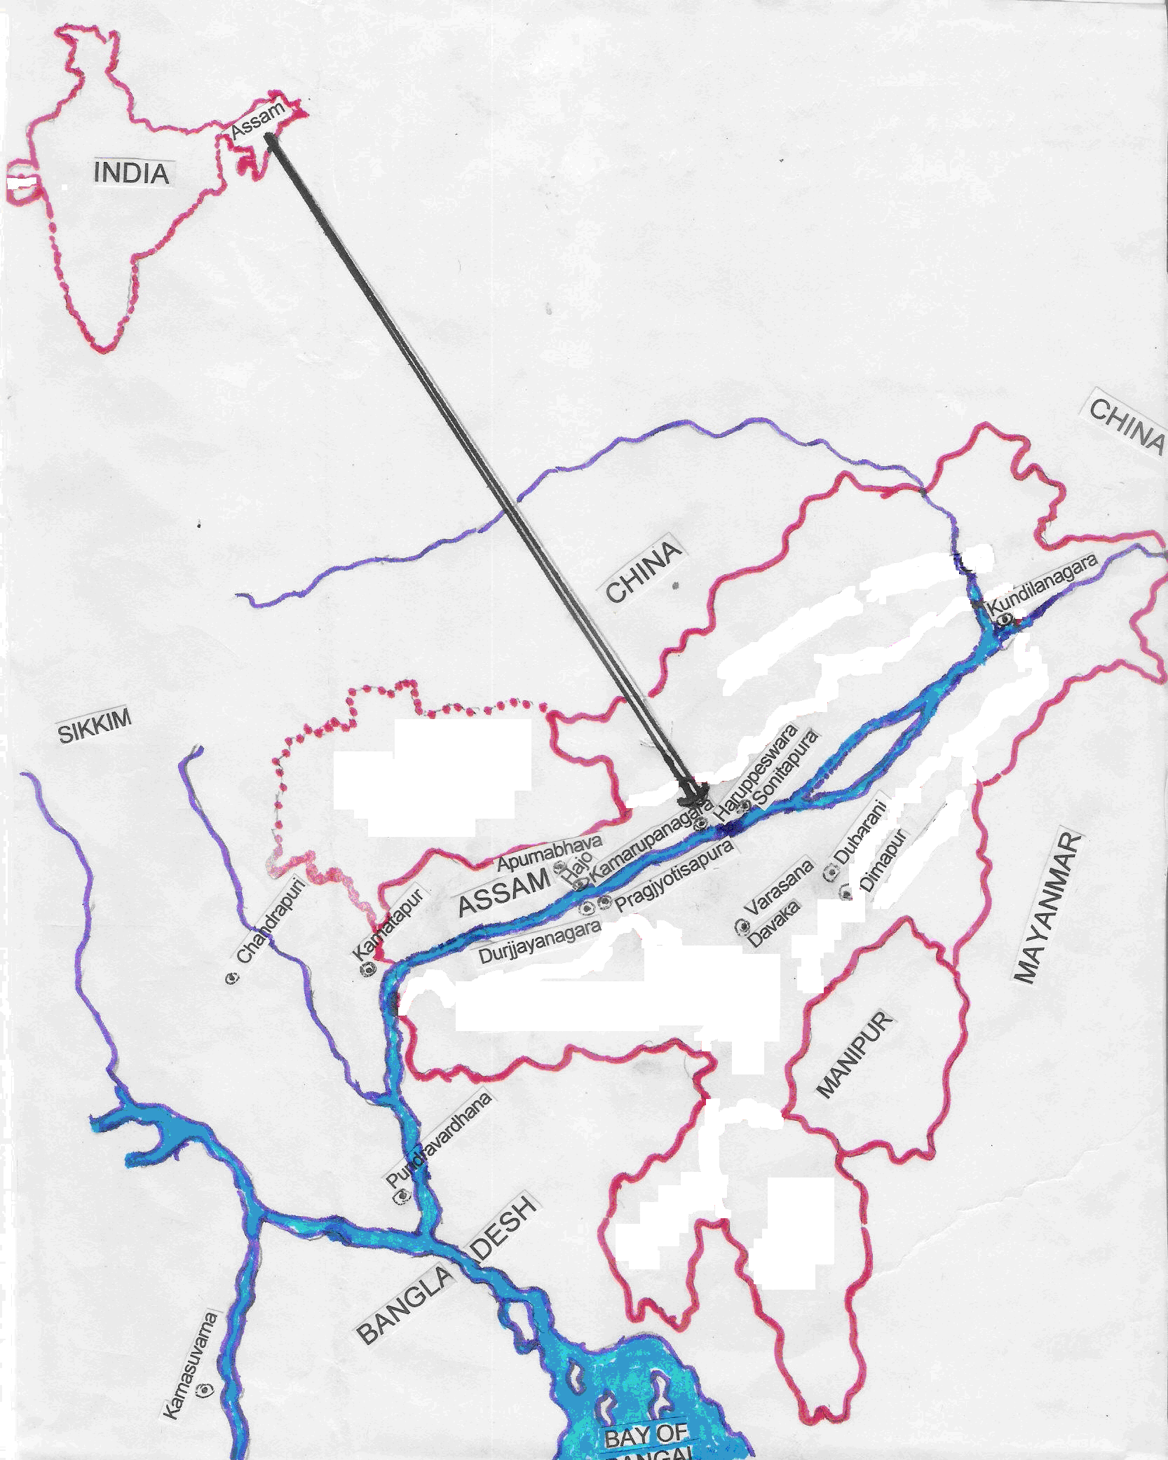

Slide 7
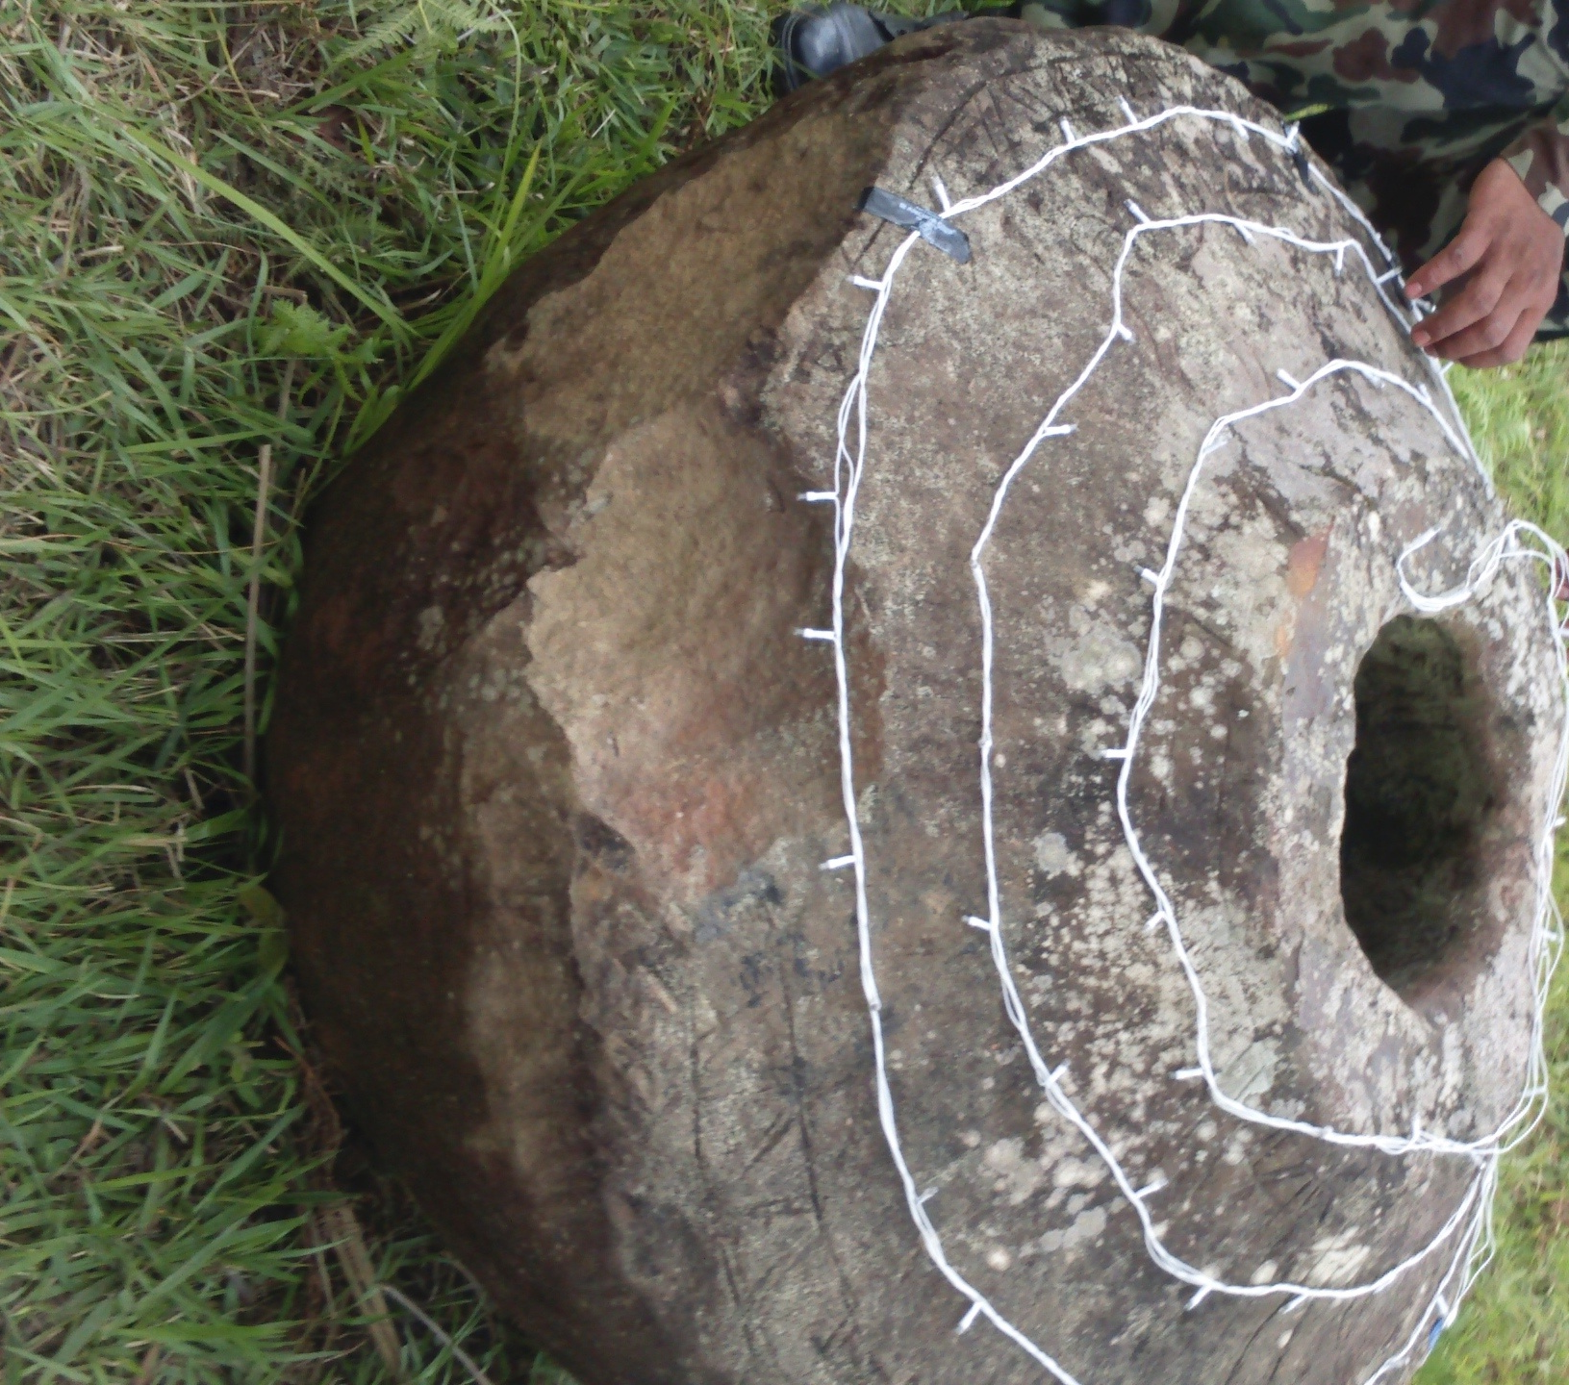
Megaliths of Khobak

Slide 8
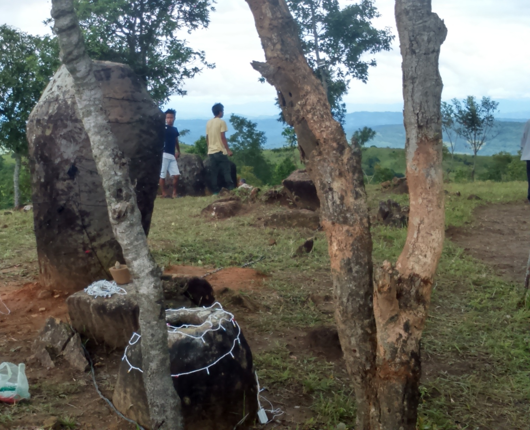
The lunjivals at khobak

Slide 9
THANK YOU

